Slide 1
Chapter 7 - Implementing Bitlocker and Applocker

Slide 2
What is application control?
Application control is a security practice that blocks or restricts unauthorized applications from executing in ways that put data at risk

Slide 3
What is application control?
Prevent all other, unauthorized applications from executing – they may be malicious, untrusted, or simply unwanted
Eliminate unknown and unwanted applications in your network to reduce IT complexity and application risk
Reduce the risks and costs associated with malware
Improve your overall network stability
Identify all applications running within the endpoint environment
Protect against exploits of unpatched OS and third-party application vulnerabilities

Slide 4
AppLocker
An application whitelisting technology introduced with Microsoft's Windows 7 operating system.
Allows restricting which programs users can execute based on the program's path, publisher, or hash.
Administrators are able to create rules based on file names, publishers or file location that will allow certain files to execute
Can be configured for an enterprise via Group Policy.
Used to group users into different enforcement levels

Slide 5
AppLocker
Control the following types of apps: executable files (.exe and .com), scripts (.js, .ps1, .vbs, .cmd, and .bat), Windows Installer files (.mst, .msi and .msp), and DLL files (.dll and .ocx), and packaged apps and packaged app installers (appx).
Define rules based on file attributes derived from the digital signature, including the publisher, product name, file name, and file version. For example, you can create rules based on the publisher attribute that is persistent through updates, or you can create rules for a specific version of a file.
Assign a rule to a security group or an individual user.
Create exceptions to rules. For example, you can create a rule that allows all Windows processes to run except Registry Editor (Regedit.exe).
Use audit-only mode to deploy the policy and understand its impact before enforcing it.

Slide 6
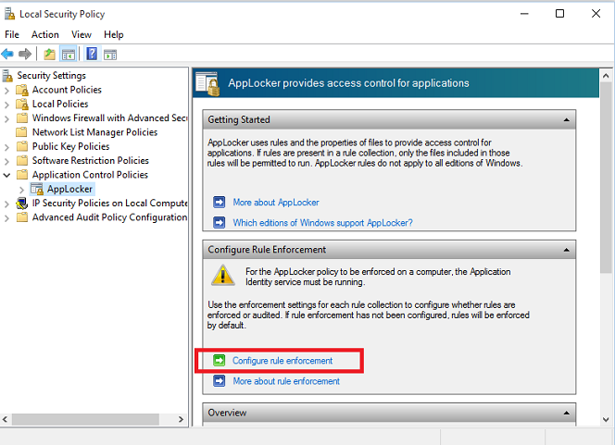
AppLocker

Slide 7
What is Full Disk Encryption?
Encryption of the hard disk at the hardware level
Automatically converting data on a hard drive into a form that cannot be understood by anyone who doesn’t have the key to “undo” the conversion
Without the proper authentication key, even if the hard drive is removed and placed in another machine, the data remains inaccessible.
As data is written, it is automatically encrypted. When it is read, it is automatically decrypted.
Can slow down data access times
Specially useful for laptops and other small computing devices that can be physically lost or stolen.

Slide 8
BitLocker
Microsoft’s easy-to-use, proprietary encryption program for Windows that can encrypt your entire drive
BitLocker is primarily designed to prevent a user’s data from being viewed, extracted or retrieved in case a drive is stolen.
BitLocker uses an AES encryption algorithm with a 128-bit key or 256-bit key to encrypt disk volumes
For best results your computer must be equipped with a Trusted Platform Module (TPM) chip. This is a special microchip that enables your device to support advanced security features.
You can use BitLocker without a TPM chip by using software-based encryption, but it requires some extra steps for additional authentication.

Slide 9
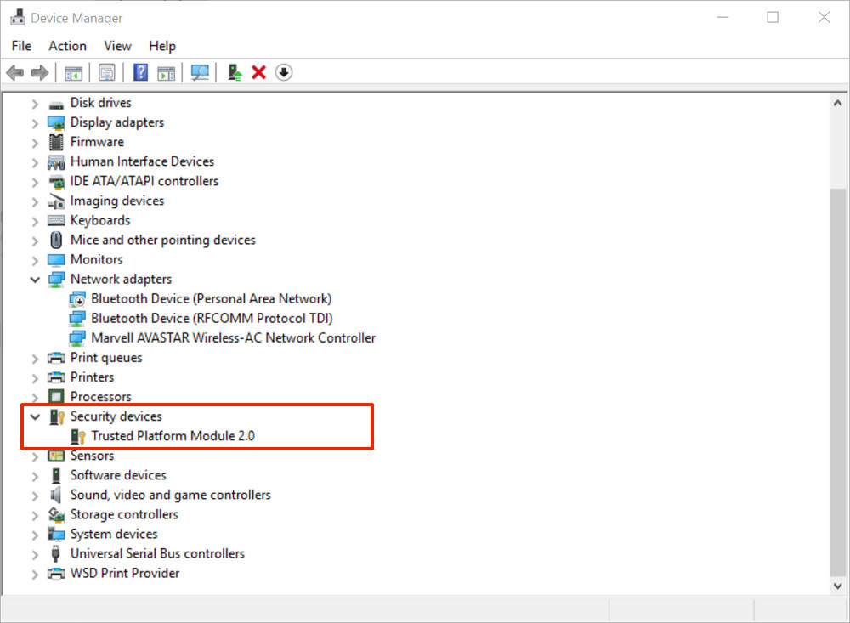

Slide 10
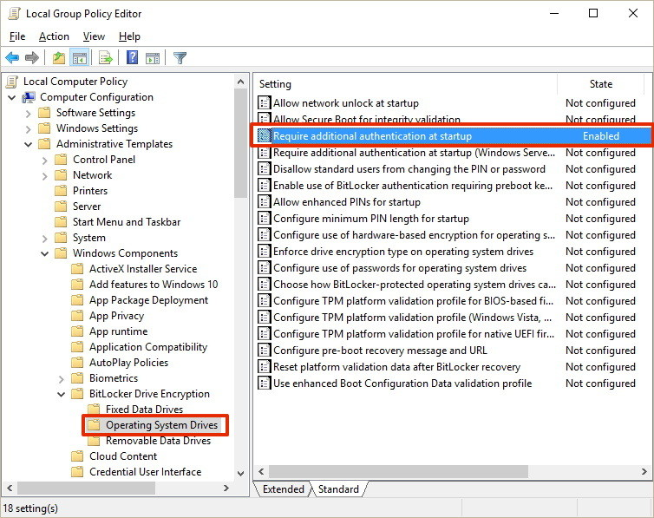

Slide 11
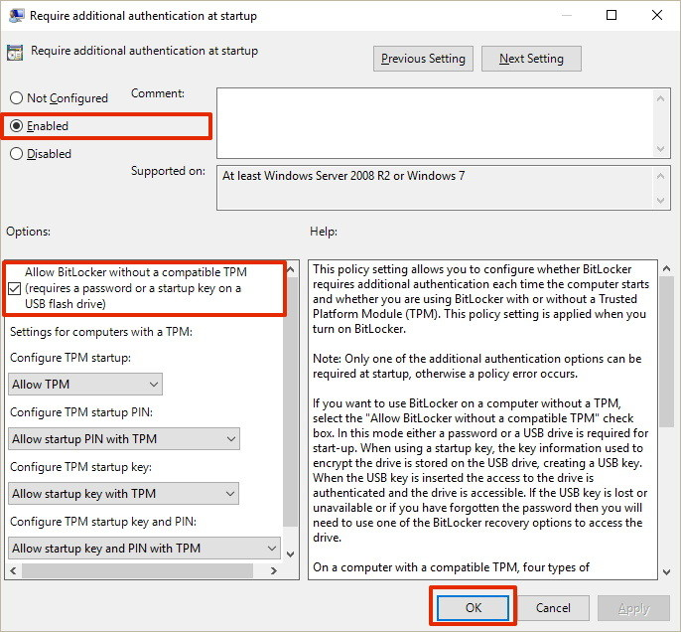

Slide 12
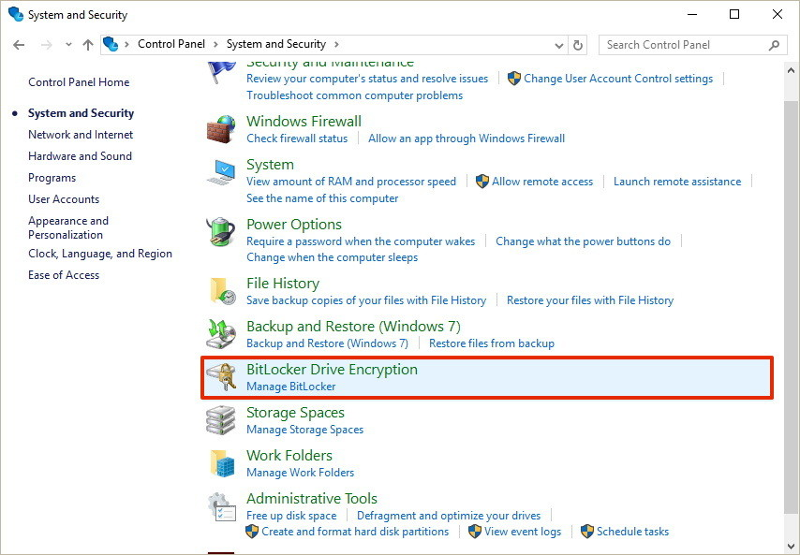

Slide 13
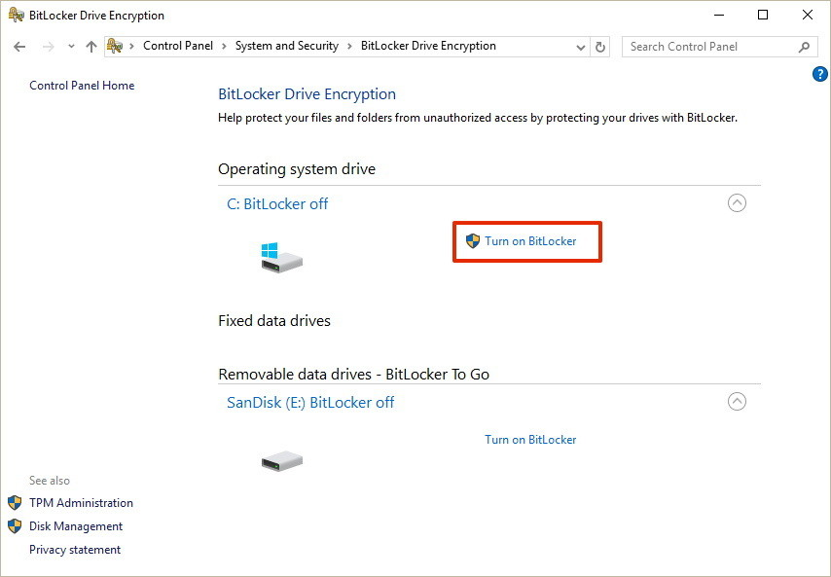

Slide 14
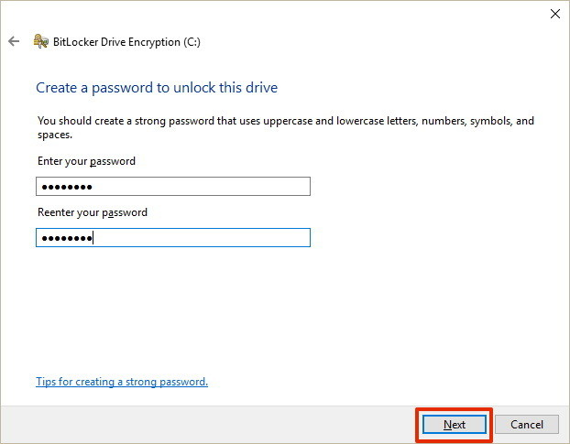

Slide 15
